Slide 1
Statistics in Data Science

Slide 2
Topics
Chi square Test
Covariance
Correlation : Pearson Correlation
Spearman Rank Correlation
Practical Implementation
Z-test, T-test, Chi-square test
F test (ANOVA)

Slide 3
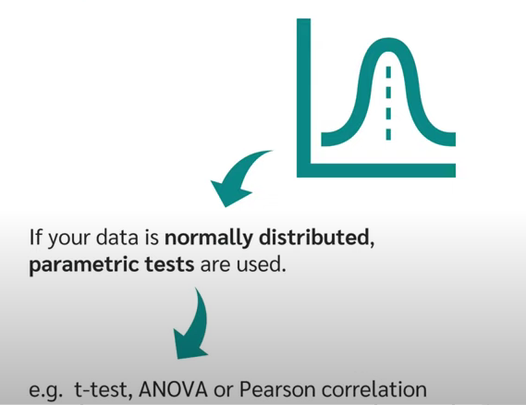
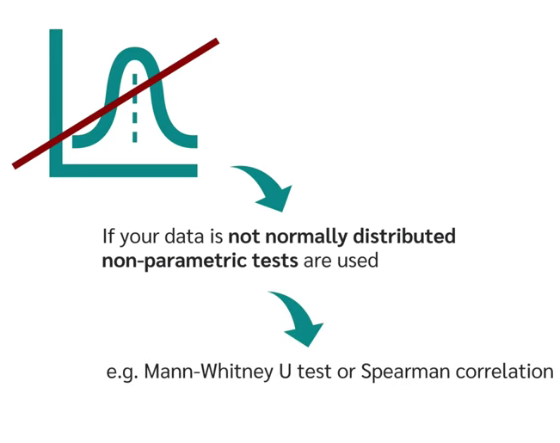
Parametric and Non-Parametric Tests

Slide 4
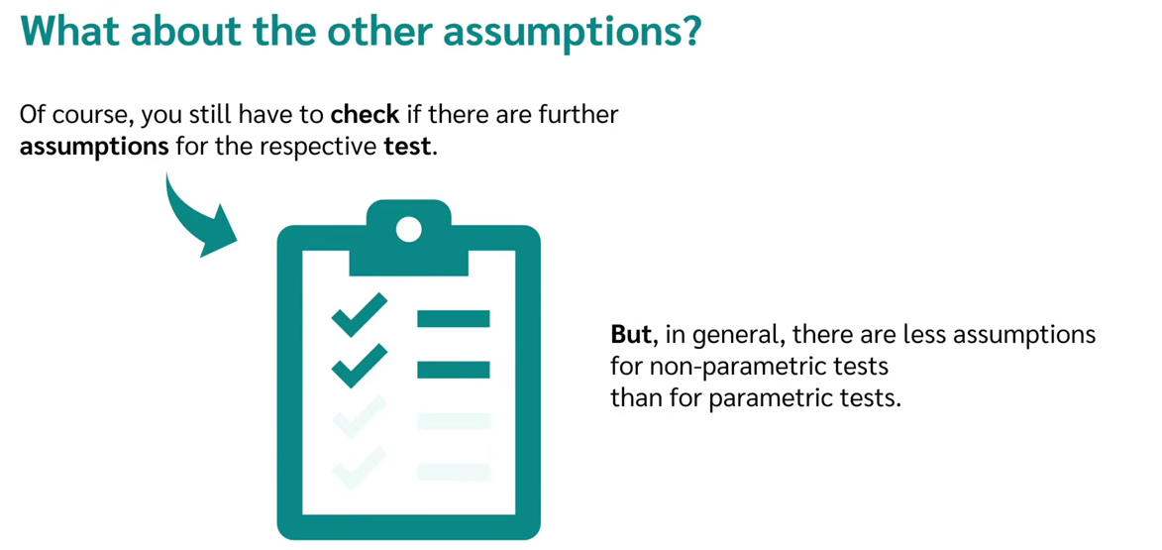
Parametric and Non-Parametric Tests

Slide 5
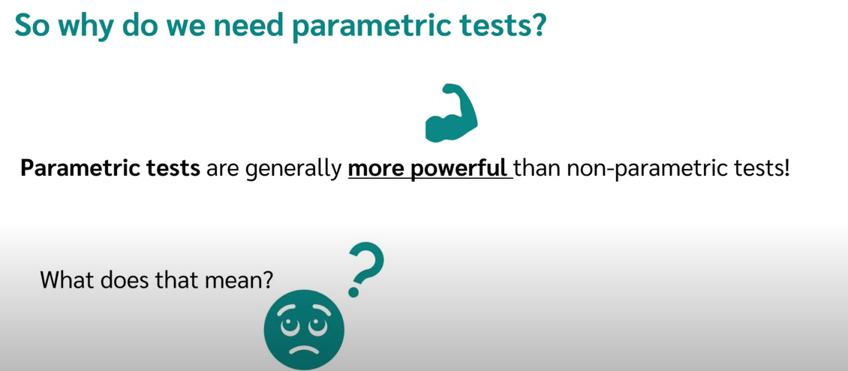

Slide 6
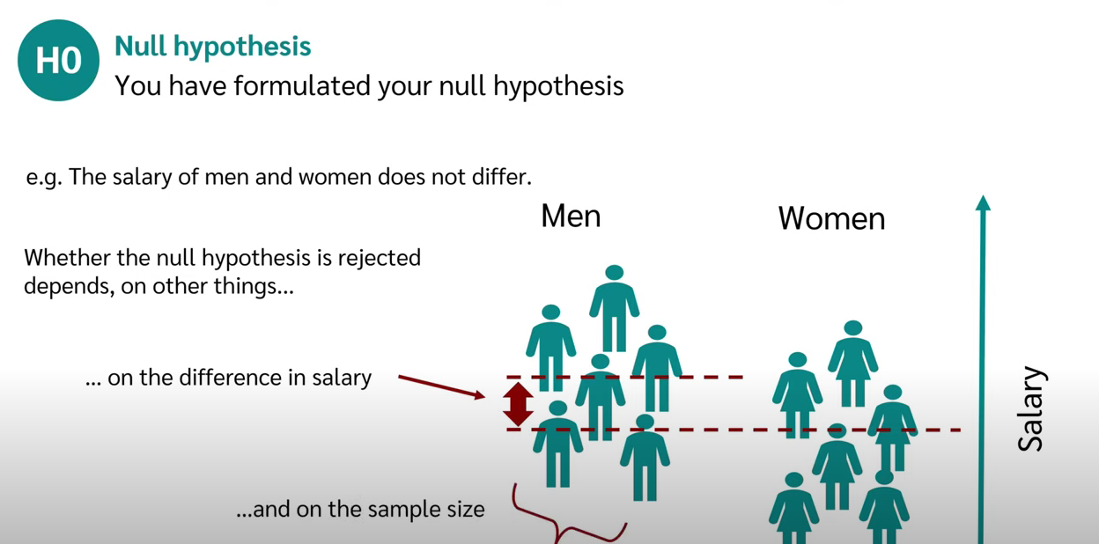

Slide 7
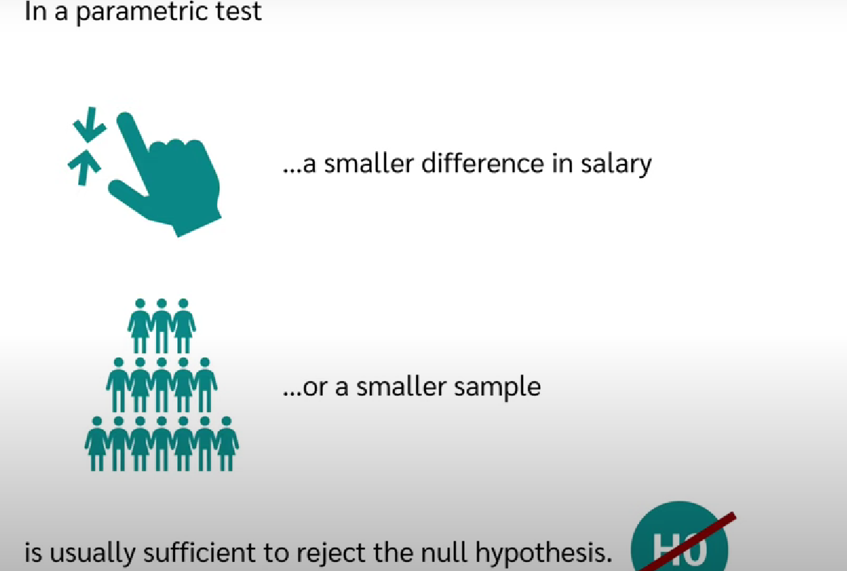

Slide 8
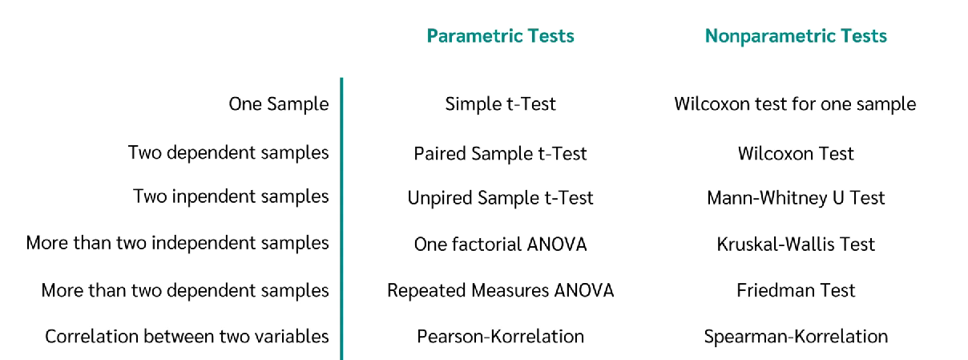

Slide 9
Independent and Dependent Variables
https://www.youtube.com/watch?v=L2pbK4ARzI8

Slide 10
Chi square Test
Its a non parametric test that is performed on categorical/nominal data.
Lets take a real time example for 500 people:-
In census 2000 of India, the ages of the individual in a small town were found to be the following:-
<18 yrs : 20%
18-35 yrs : 30%
>35 yrs : 50%
Again, they took census in 2010, <18 yrs : 121
18-35 yrs : 288
>35 yrs : 91
Using alpha = 0.05, would you conclude that population distribution of ages has changed in the last 10 yrs?

Slide 11
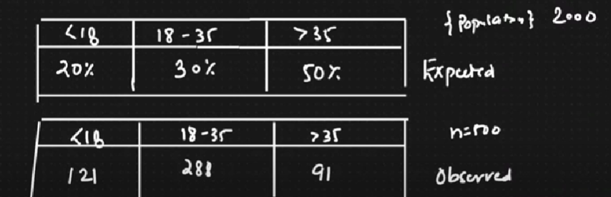

Solution:

Slide 12
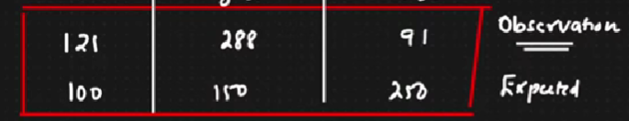
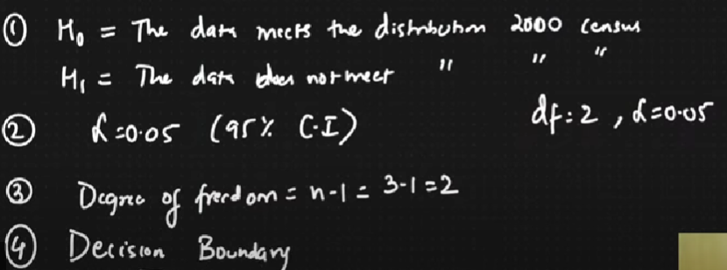
Chi square Test : Solution

Slide 13
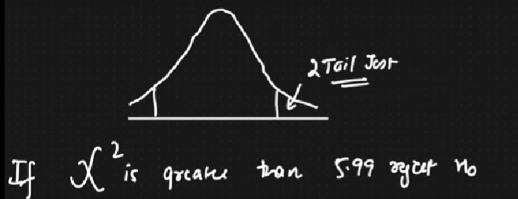
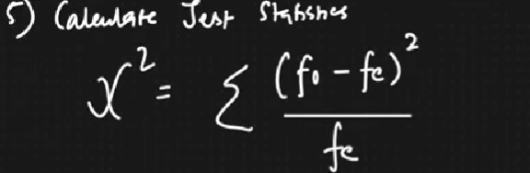
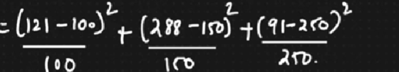
Is it a two-tailed or one tail-test?
https://people.richland.edu/james/lecture/m170/tbl-chi.html : Chi square table

Slide 14
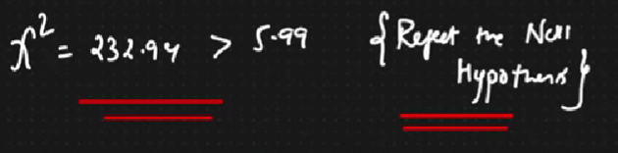
Is it a two-tailed or one tail-test?
232.94 is Chi square, so do we reject/accept the null hypothesis?

Slide 15
Interview Question:
Suppose an IQ in a certain population is normally distributed with a mean of 100 and sd =15. A researcher wants to know if a new drug affects IQ levels so he gets 20 patients to try out and record their IQ levels?
We will perform this test in python now.

Slide 16
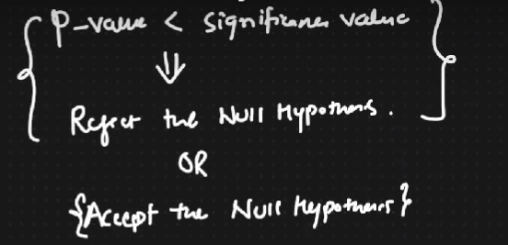
Final takeaway: Hypothesis Testing

Slide 17
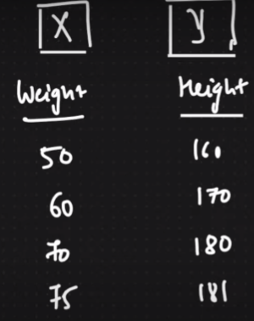
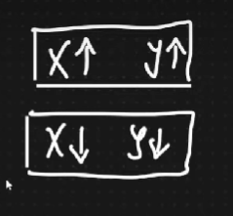
Covariance
Take 2 variables

Slide 18
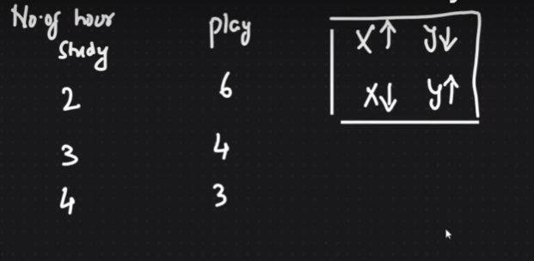
Covariance

Slide 19
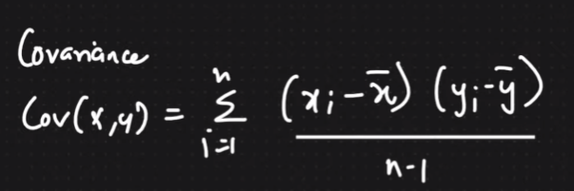
Quantify relationship between X and Y

Slide 20
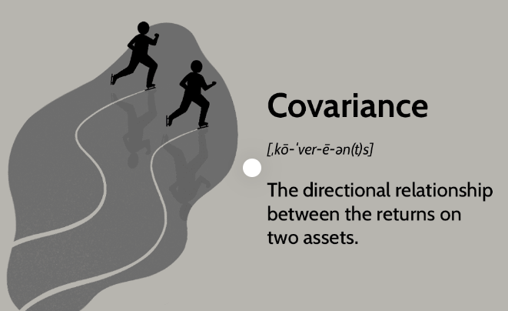

Slide 21
Disadvantage of covariance
Positive or Negative Values (values can be within any range, magnitude is not limited)
So, for two distribution, lets say how much + and how much -, we wont be able to identify.
So, we need to restrict these values. Here comes the solution i.e. Pearson Correlation Coefficient.

Slide 22
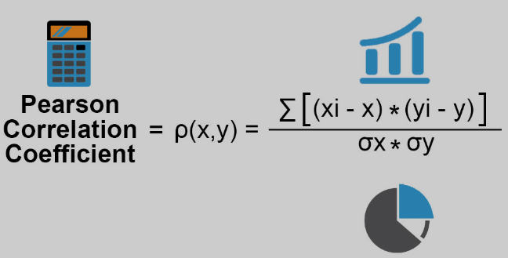
Pearson Correlation Coefficient

Slide 23
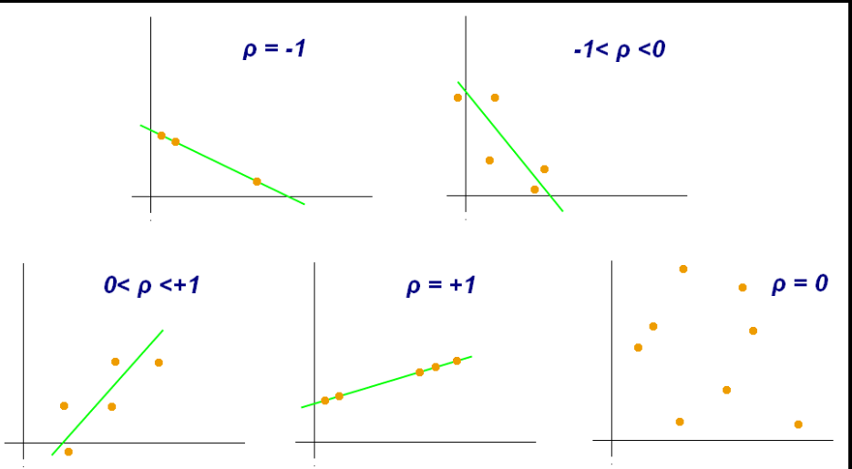
Pearson Correlation Coefficient

Slide 24
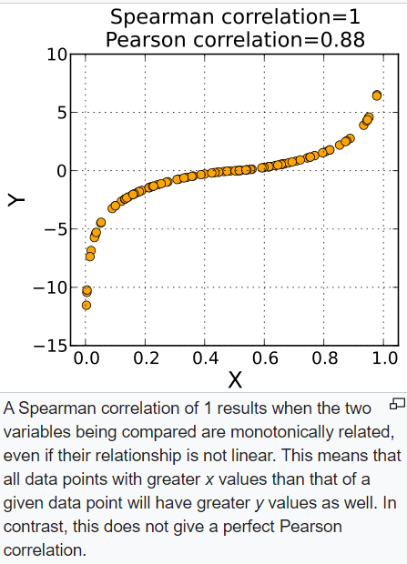
Spearman’s Rank Correlation
Pearson Correlation
Coefficient reflects
the strength and direction
of linear relationship.
Spearman explains
non-linear relationship too!

Slide 25
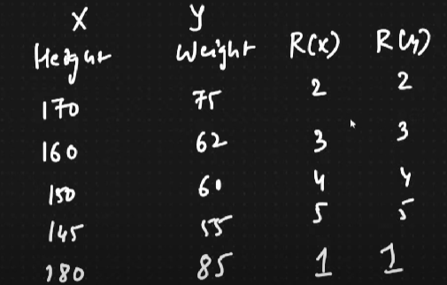
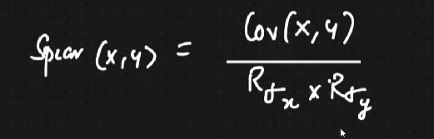
Spearman’s Rank Correlation

Slide 26
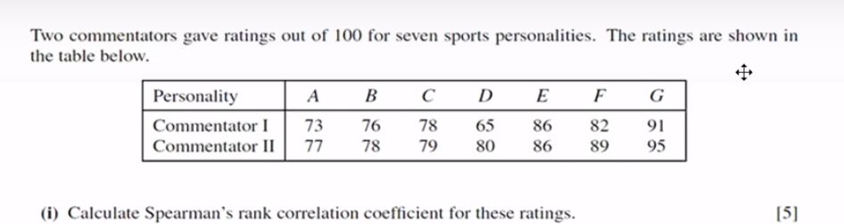
Find out Spearman Rank Correlation Coefficient

